Slide 1


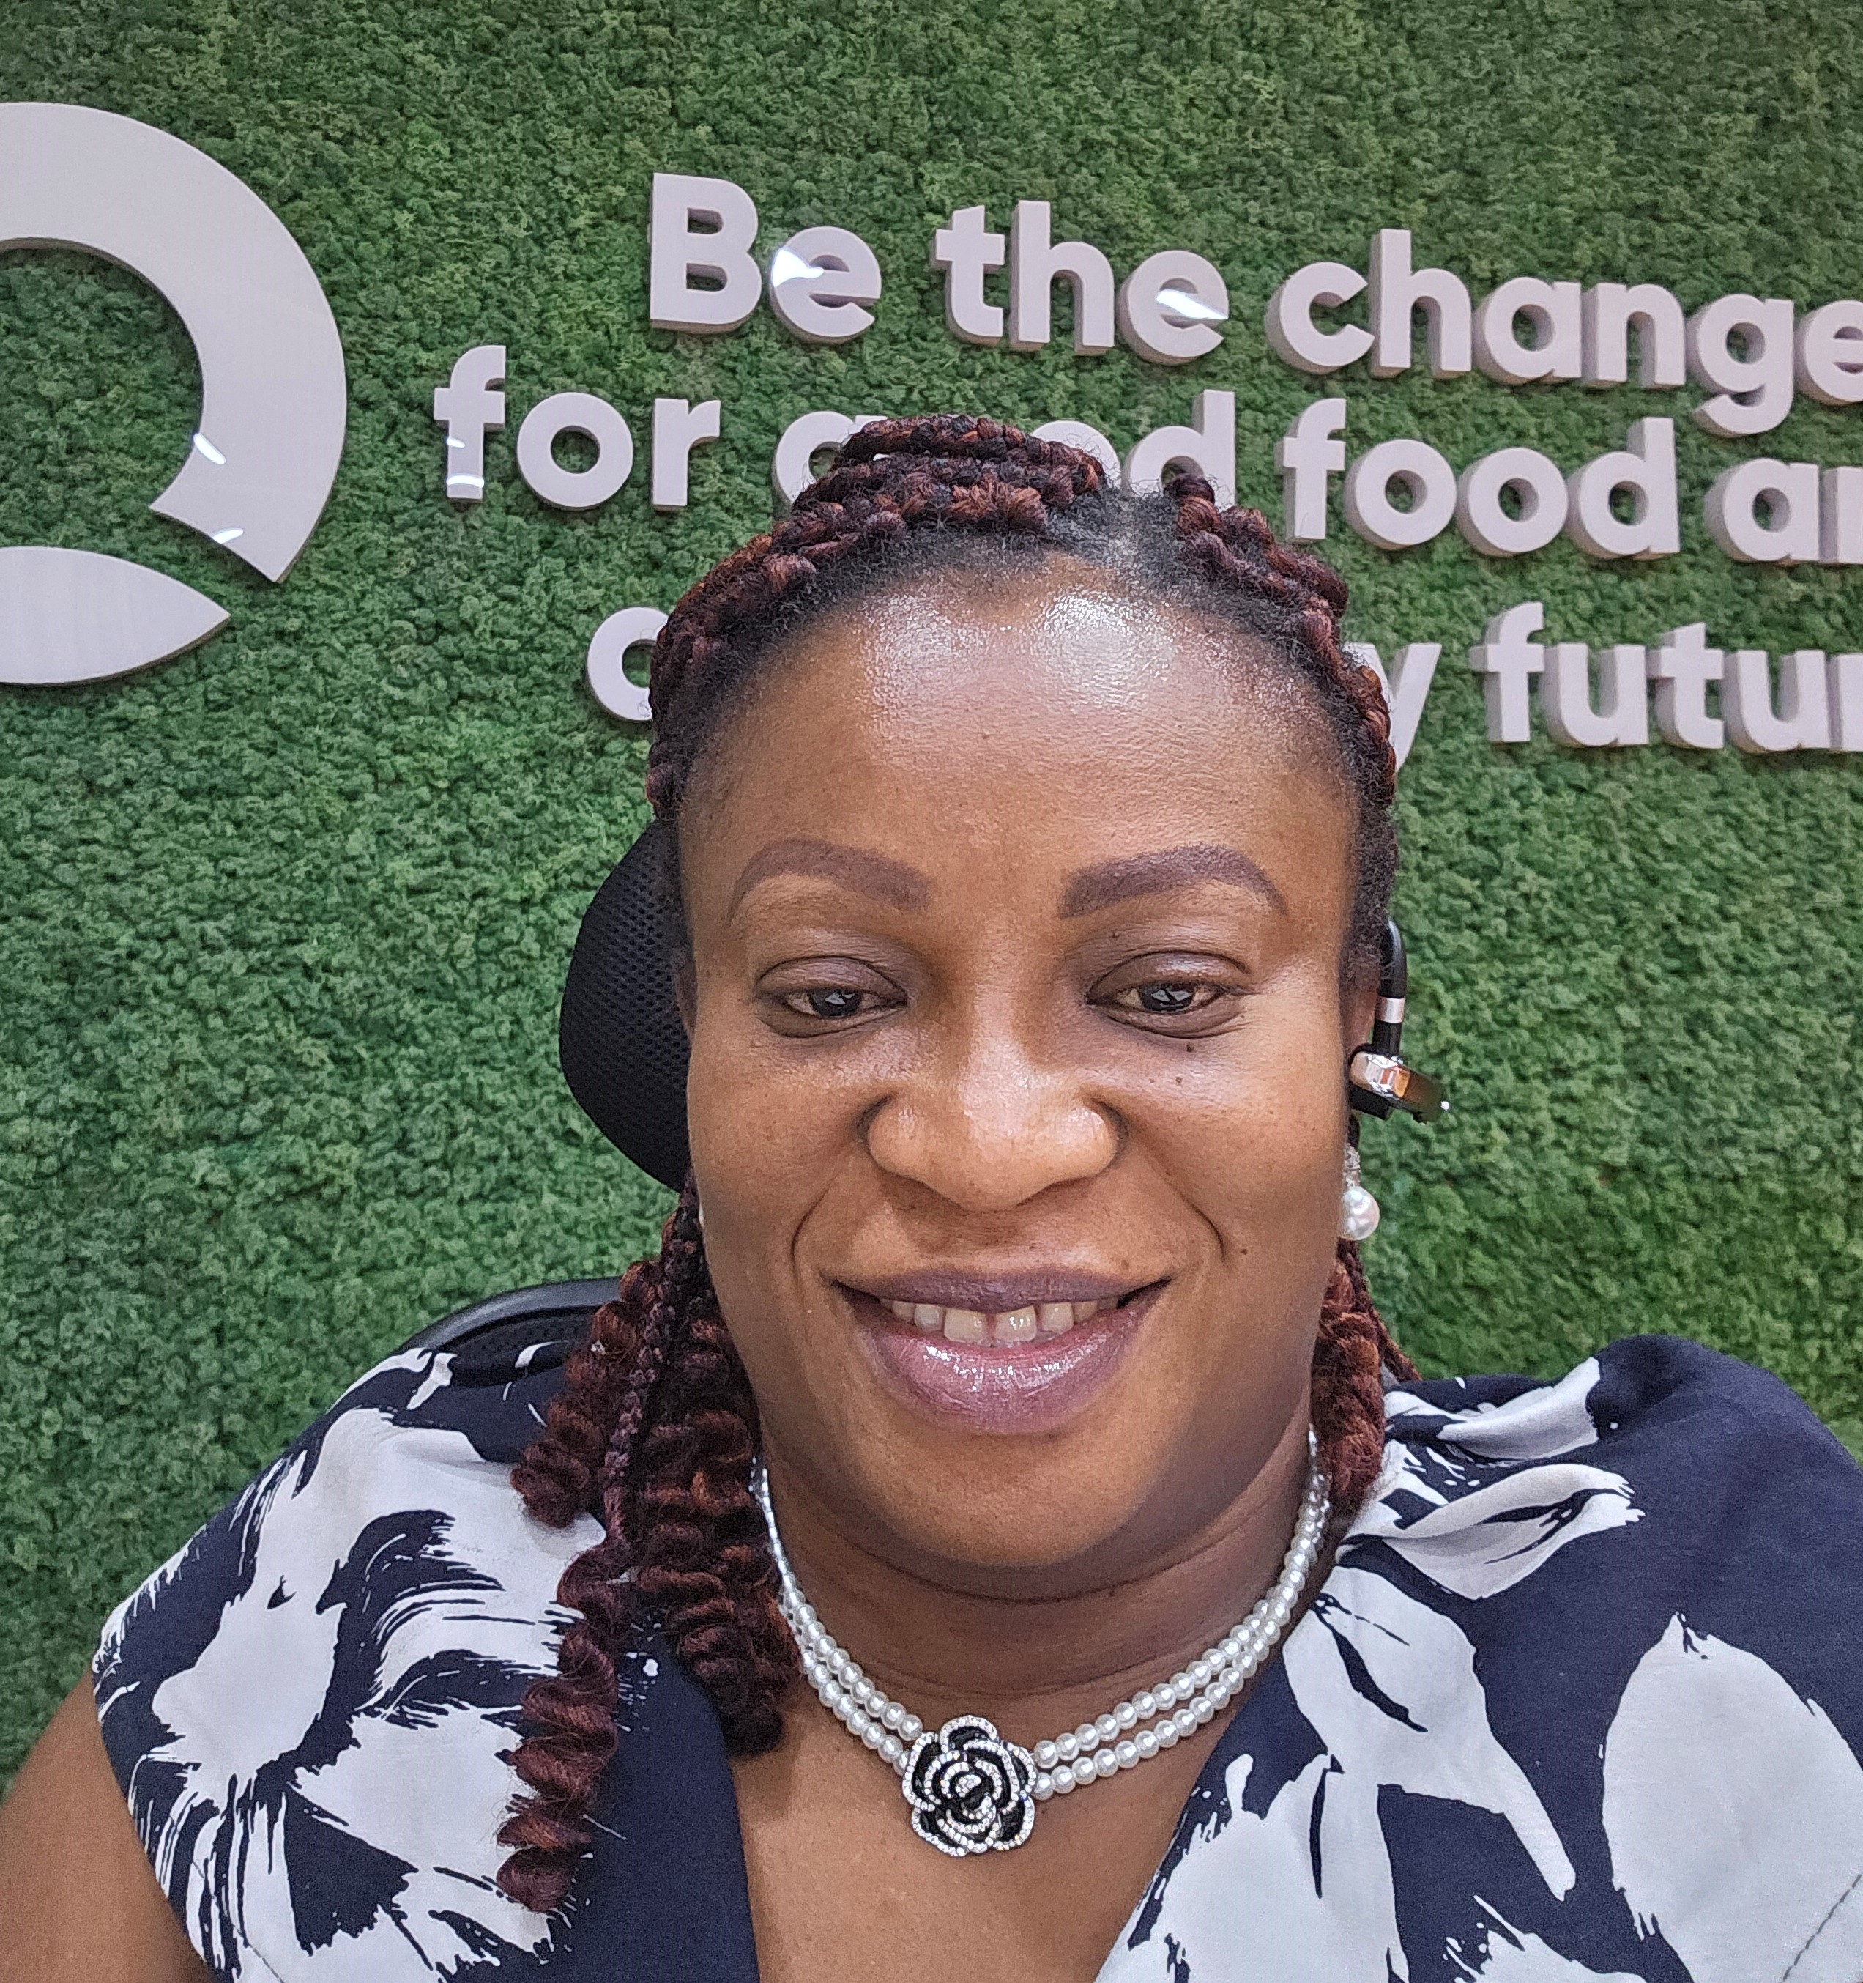
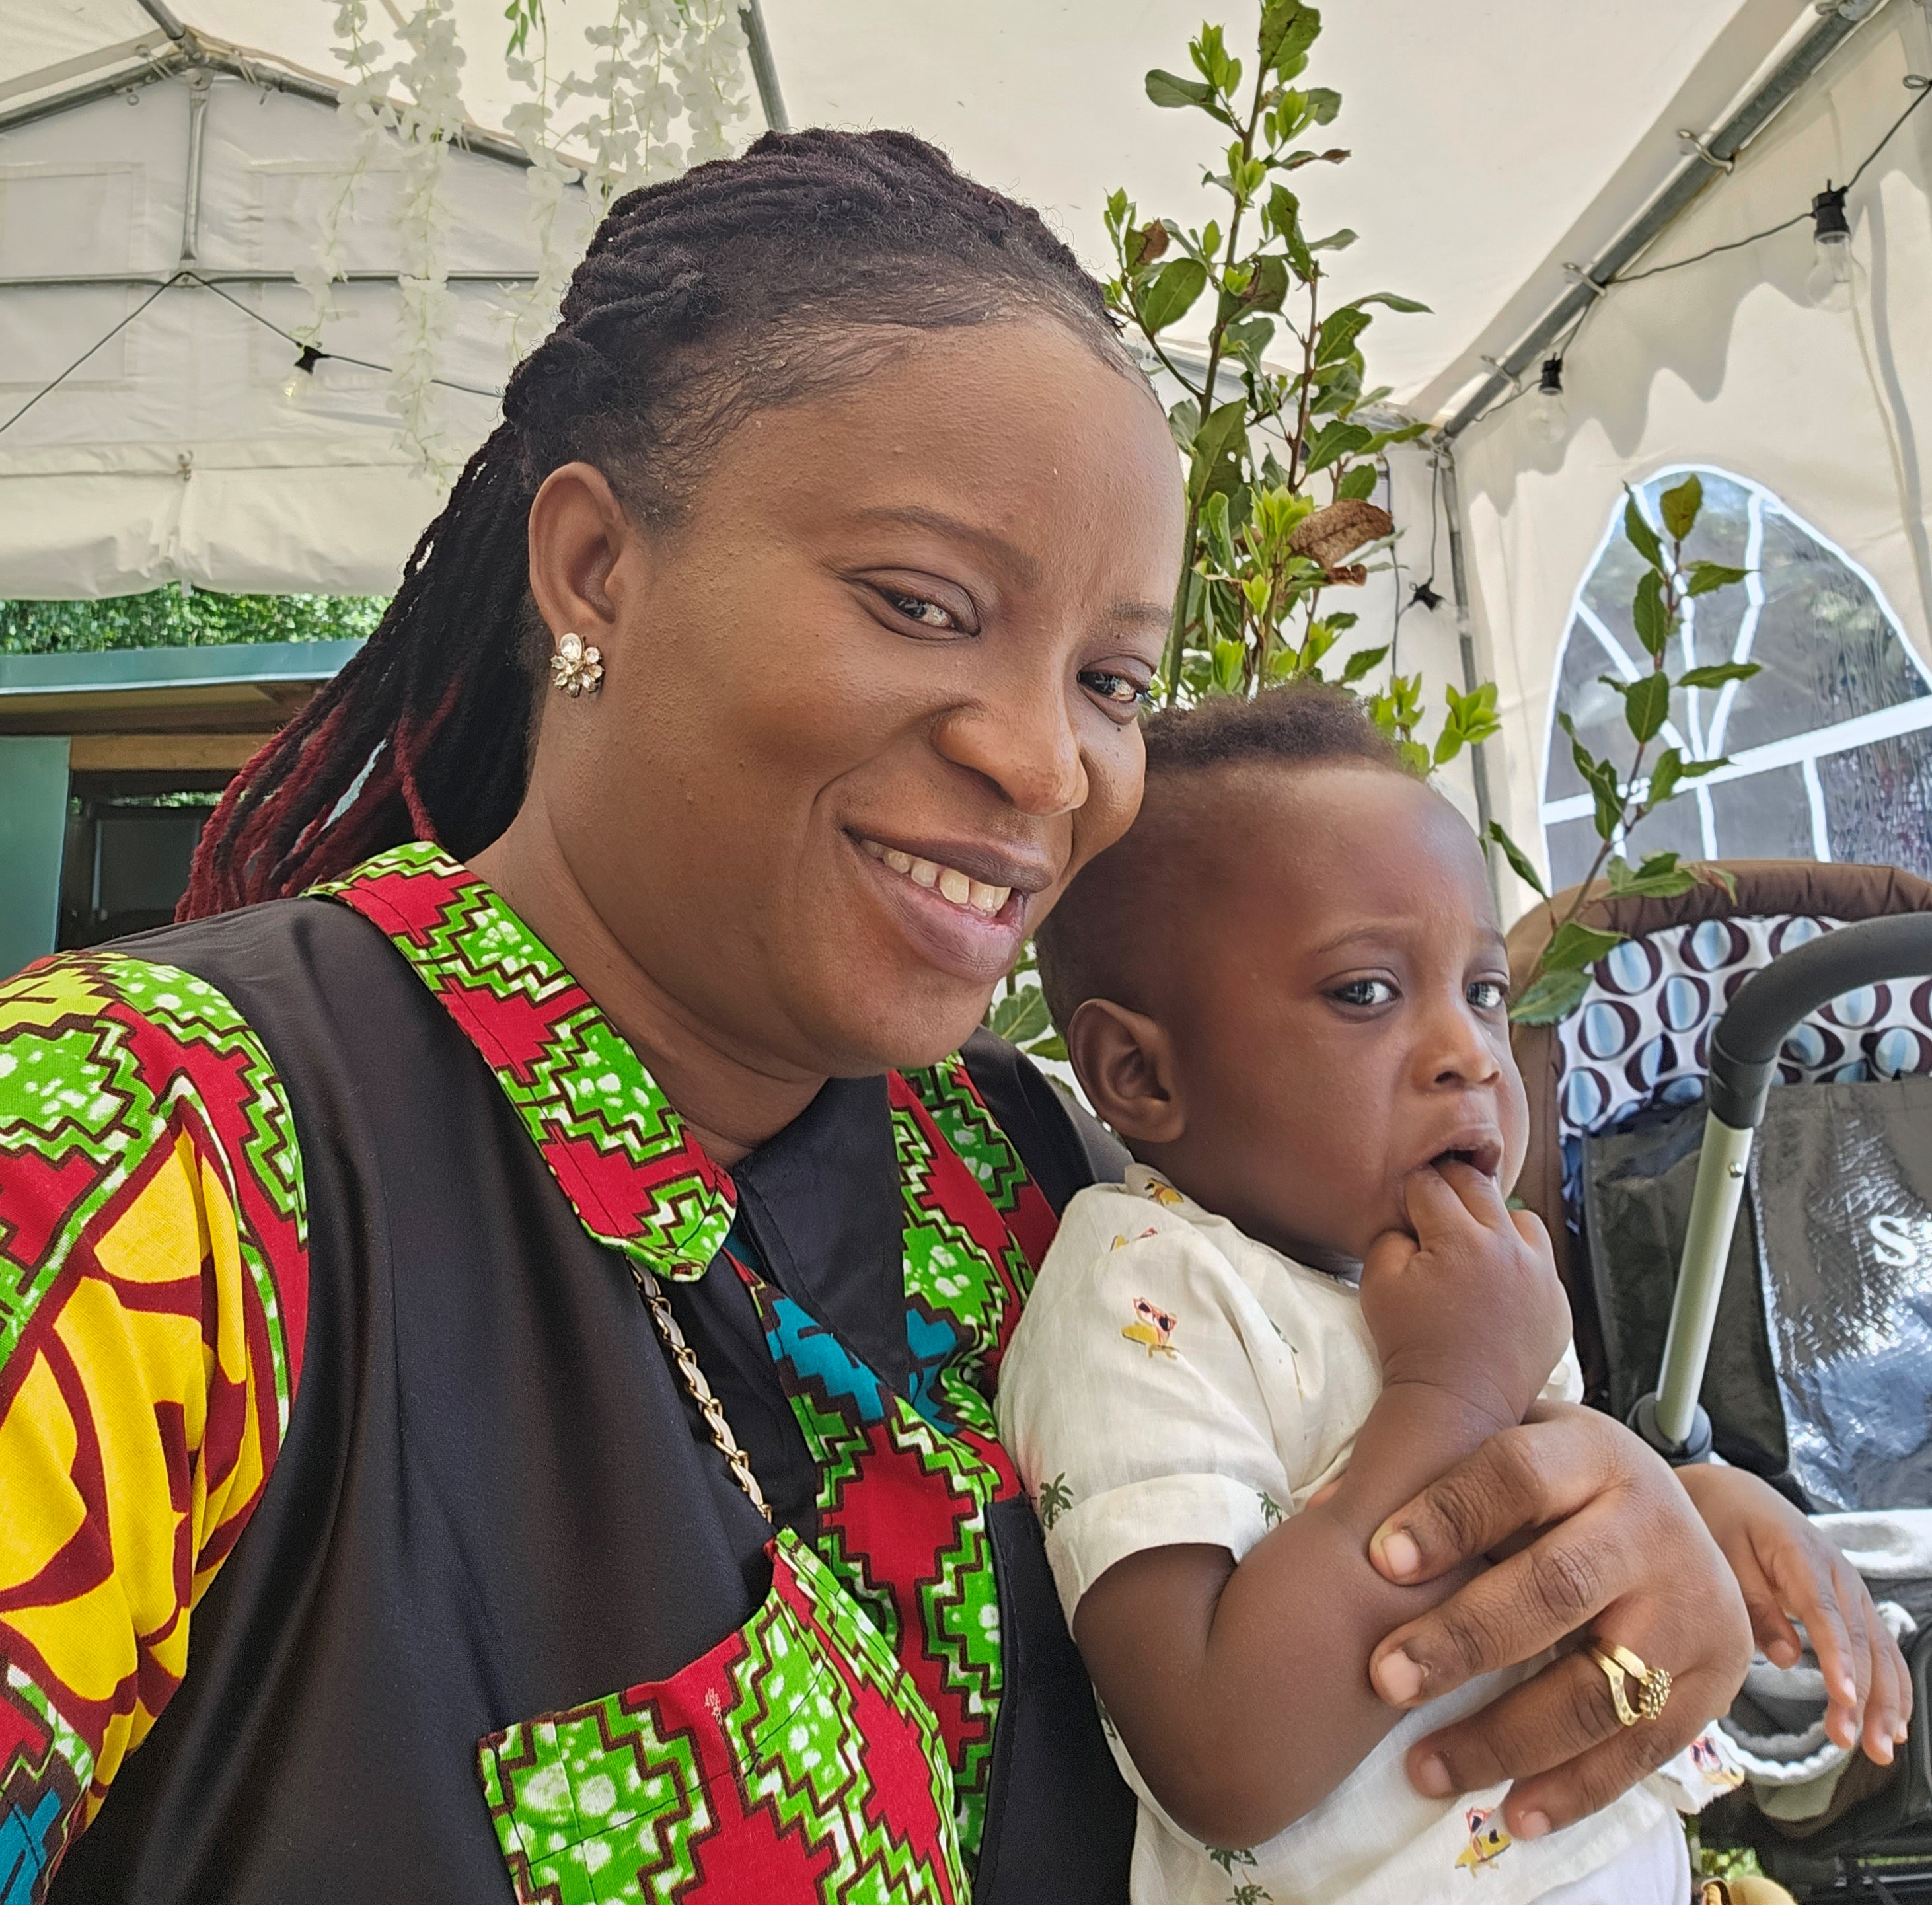
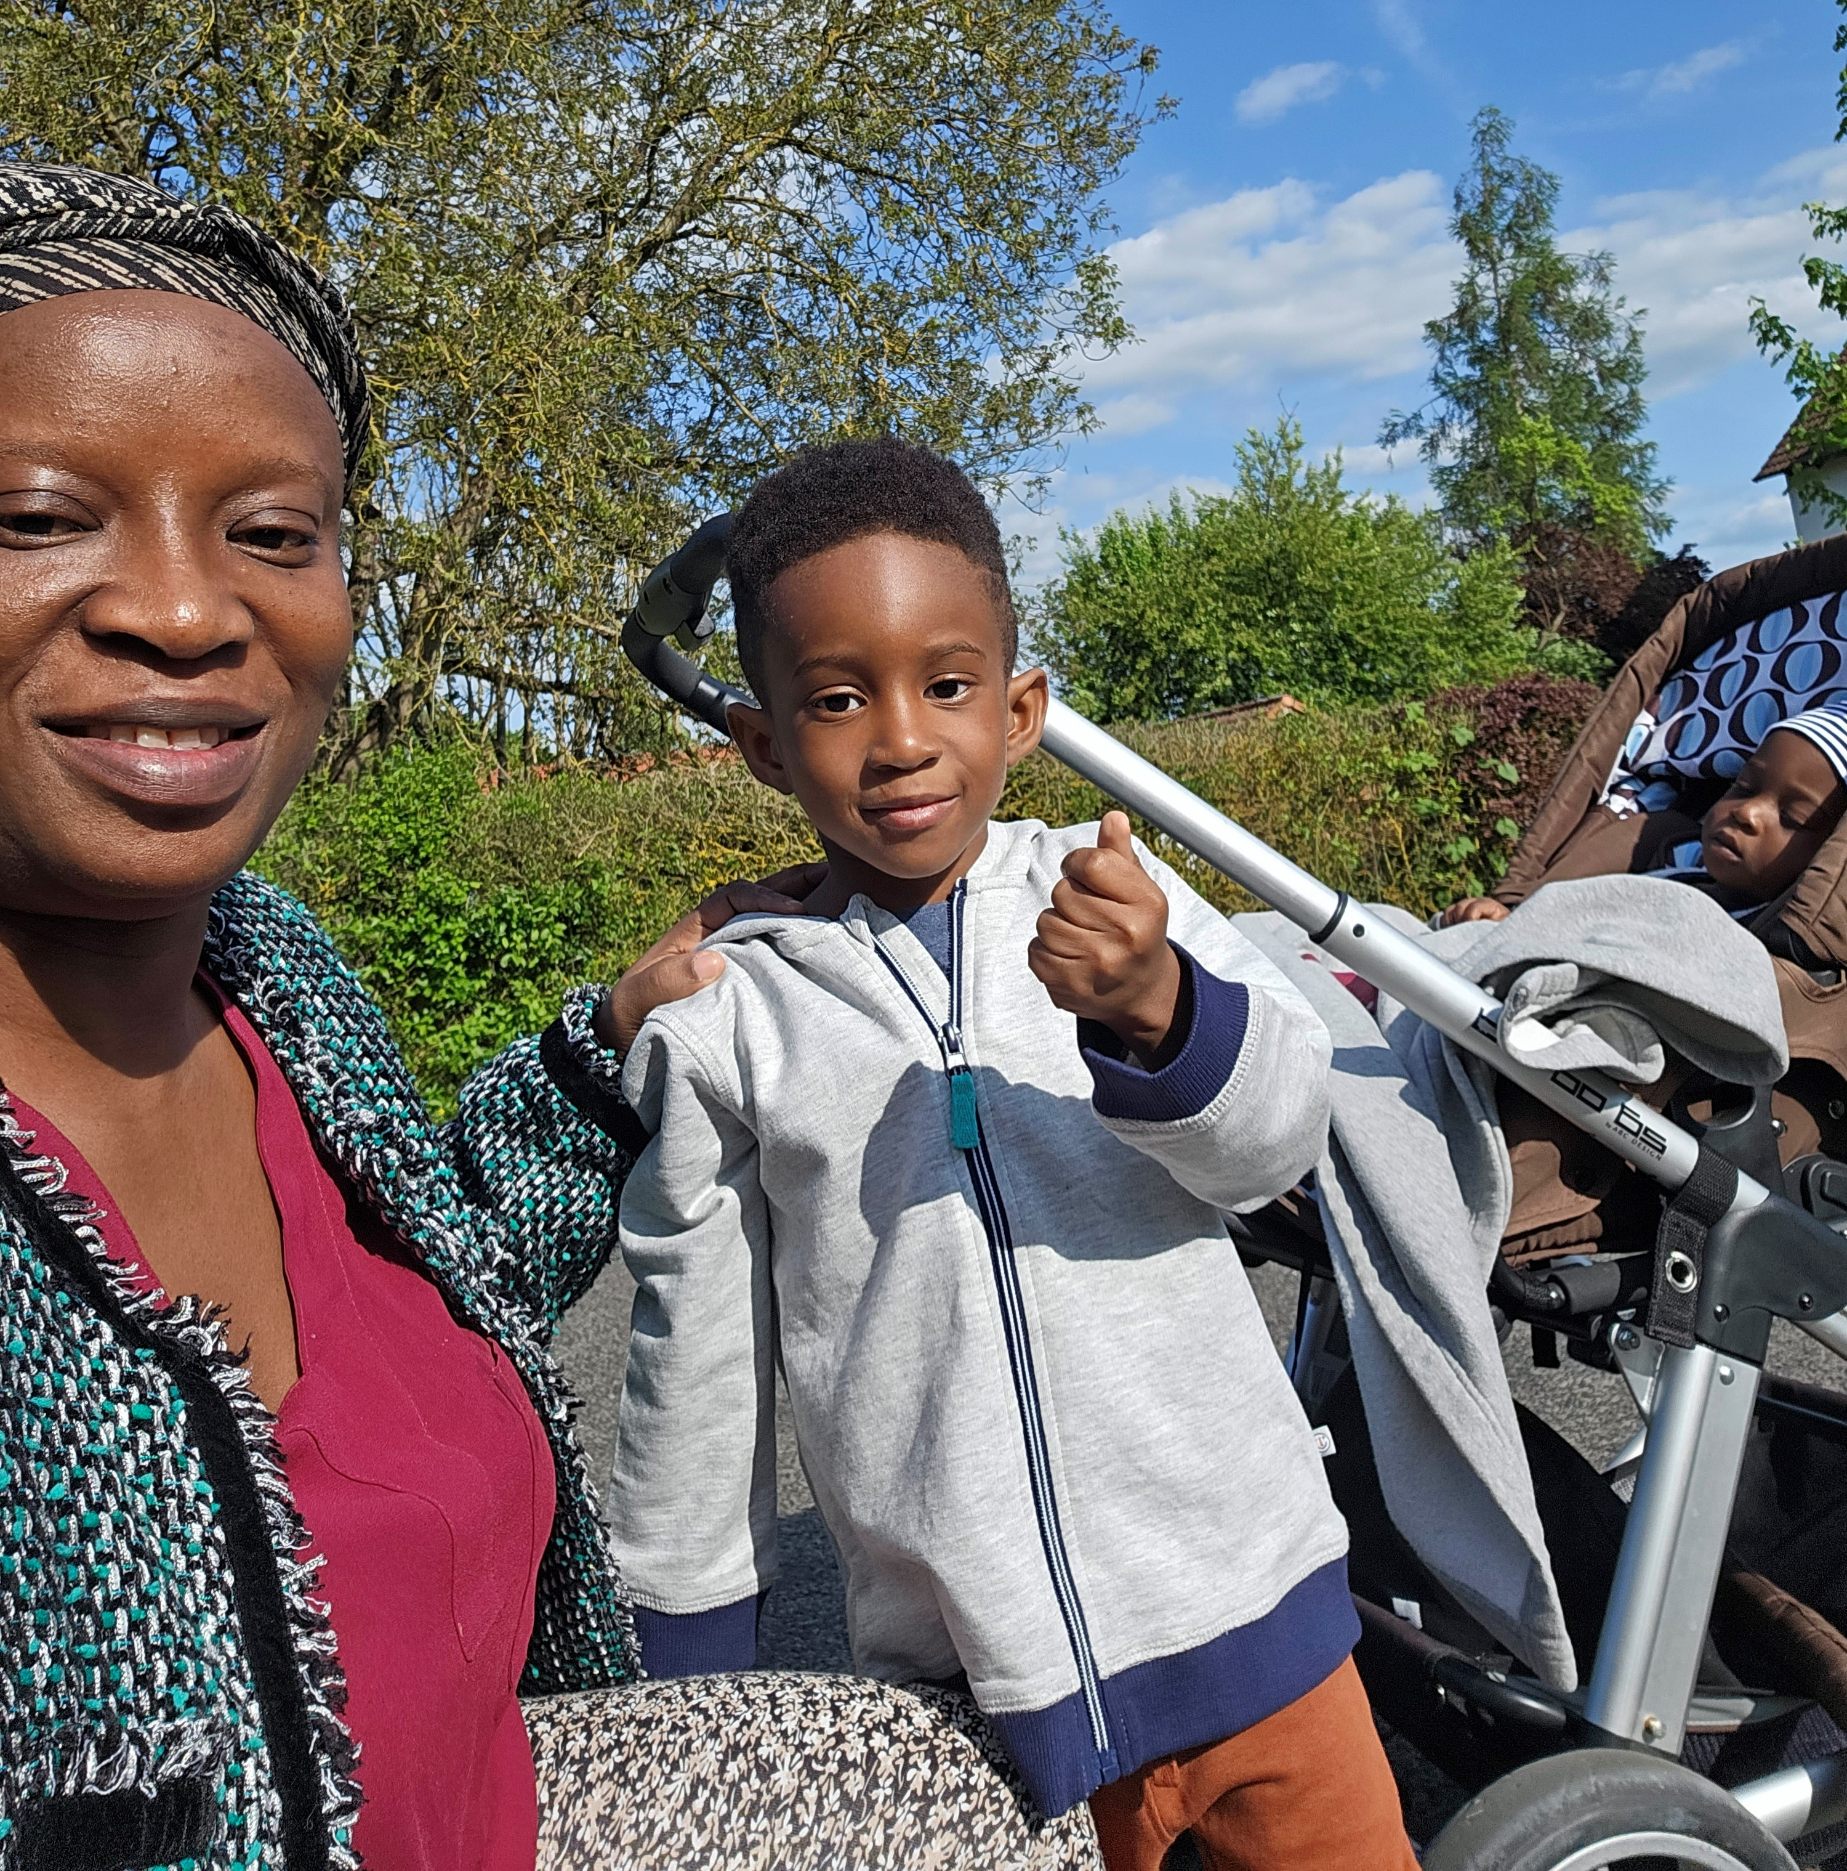
Getting to Know Me
Work
Personal
My role
PROCUREMENT COORDINATOR FOR THE BEAN BUSINESS IFOR THE CENTRAL AND ASHANTI AREA
Significant others / family members / furry friends in my life
SLEDGE, OBREMPONG. OHENE/ DOG
Tenure in ofi/Olam
12 YEARS
How I enjoy spending my free time
SPENDING TIME WITH THE FAMILY AND TRAVELLING
Previous companies I have worked at
ARMAJARO/AGROECOM
My favorite / comfort food
FUFIU WITH CHICKEN SOUP
Why I joined ofi/Olam and what keeps me here?
TO LEARN MORE AND THE EXPOSURE AND TRAININGS ARE KEEPING ME
My favorite song
ANY FOREIGN GOSPEL SONG THAT INSPIRES
HANNAH BAWUA-MAINOO
‘what name you prefer to be called’
A few fun facts about me
WOMEN EMPOWERMENT
ENCOURAGING AND INSPIRING OTHERS
I MET MY HUSBAND ON THE JOD
This is me outside work, doing stuff I enjoy in my life …

